Slide 1

Case Study: Kepler’s Third Law
Professor Bo Liu
James Watt School of Engineering

Slide 2
Introduction
In 1618, Johannes Kepler discovered that the orbital period of the planets in the solar system is proportional to the cubic of the mean orbital radius.
In this case study we will:
  Graphically show this relationship.
  Compute the predicted orbital periods of Uranus and Neptune (undiscovered planets in 1618).
  Compare the predicted orbital periods against the actual orbital periods.
You will learn about:
  log – log plots in MATLAB.
  How to calculate a line of best fit in MATLAB.
  How to import data from a csv file in MATLAB.
See live script

Slide 3
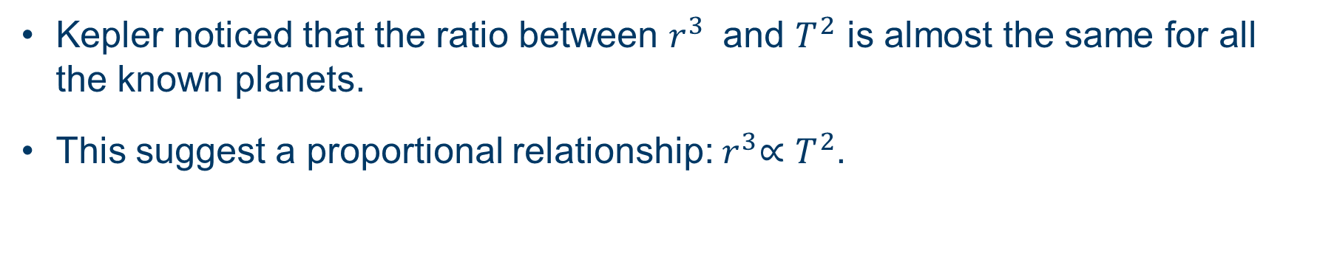
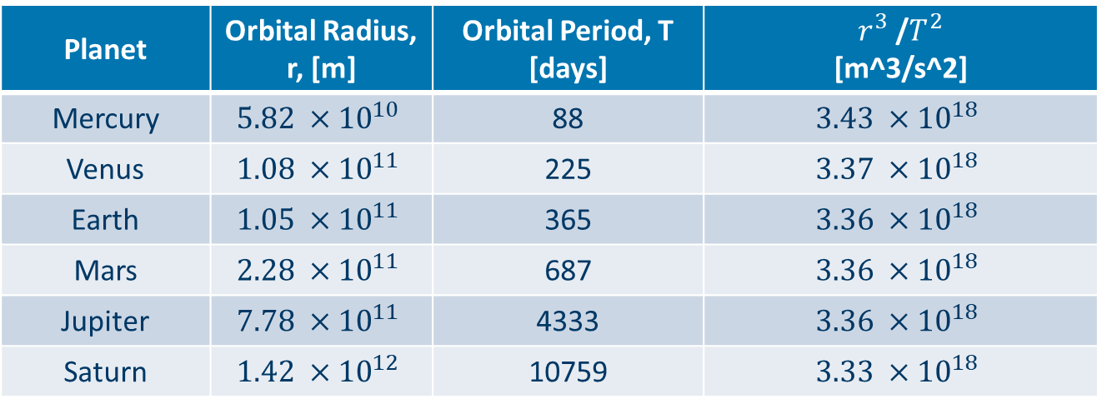
Kepler's planetary data from 1618
Planet | Orbital Radius, r, [m] | Orbital Period, T [days] | $r^{3}$/$T^{2}$ [m^3/s^2]
Mercury | $$5.82 ×{10}^{10}$$ | 88 | $$3.43 ×{10}^{18}$$
Venus | $$1.08 ×{10}^{11}$$ | 225 | $$3.37 ×{10}^{18}$$
Earth | $$1.05 ×{10}^{11}$$ | 365 | $$3.36 ×{10}^{18}$$
Mars | $$2.28 ×{10}^{11}$$ | 687 | $$3.36 ×{10}^{18}$$
Jupiter | $$7.78 ×{10}^{11}$$ | 4333 | $$3.36 ×{10}^{18}$$
Saturn | $$1.42 ×{10}^{12}$$ | 10759 | $$3.33 ×{10}^{18}$$
Kepler noticed that the ratio between $r^{3}$ and $T^{2}$ is almost the same for all the known planets.
This suggest a proportional relationship:${ r}^{3}∝T^{2}$.
See live script

Slide 4
Creating log - log plot
The first step is to load the data into MATLAB from a csv file:
Plotting this two arrays on a graph with logarithmic axes plot:
keplers_data = readtable("Keplers_data.csv"); % load csv file
radi = keplers_data.radius % access the “radius” column of table
periods = keplers_data.period % access the “period” column of table
loglog(periods, radi, 'o') % ‘o’ marker to use for data points
xlabel("Orbital Period [days]")
ylabel("Orbital Radius [m]")
title("Period and radius of Planets in the solar system")
grid()
See live script

Slide 5
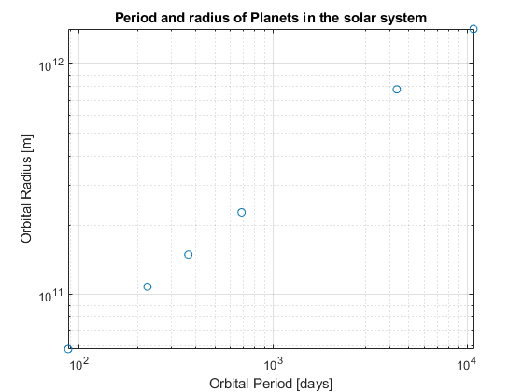
Planetary data on logarithmic axes
On a logarithmic plot, the data points give an almost straight line.
See live script

Slide 6

Line of best fit via polyfit function
The “polyfit(x,y,n)” function fits a polynomial of order n to a series of x and y datapoints.
  By specifying n=1 we can obtain a line of best fit.
Calculate the line of best fit in the form ($y = m∗x + c):$
Add to plot:
p = polyfit(log(periods), log(radi), 1) % line of best fit
m = p(1) % slope is stored as first element
c = p(2) % y-intercept is stored as second element
x_pts = [min(periods), max(periods)] % range to plot a line
line_pts = m.*log(x_pts) + c; % evaluate the line
hold on % add to existing plot
plot(x_pts, exp(line_pts))
legend(["Kepler’s data", “Line of best fit"])
See live script

Slide 7
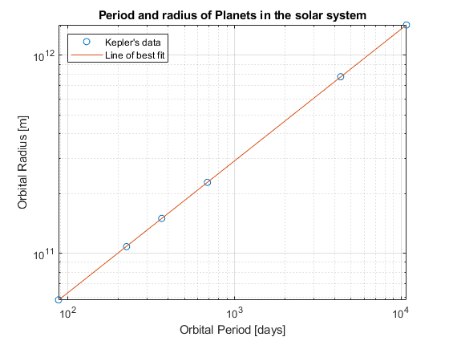
Line of best fit through Kepler’s data
See live script

Slide 8
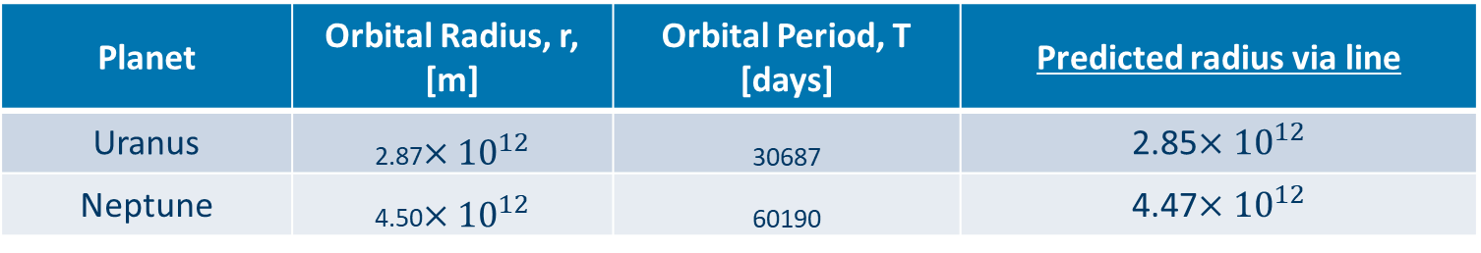
Uranus and Neptune
Uranus and Neptune were discovered later
Using the Line of best fit to predict radius of Uranus and Neptune:
This provides the predicted radius values in the table.
  Extremely good predictions.
Planet | Orbital Radius, r, [m] | Orbital Period, T [days] | Predicted radius via line
Uranus | 2.87$×{10}^{12}$ | 30687 | 2.85$×{10}^{12}$
Neptune | 4.50$×{10}^{12}$ | 60190 | 4.47$×{10}^{12}$
x_pts2 = [30687, 60190]; % periods of Uranus and Neptune
line_pts2 = m.*log(x_pts2) + c; % lines prediction for log(R)
predicted_periods = exp(line_pts2) % predicted radius
See live script

Slide 9
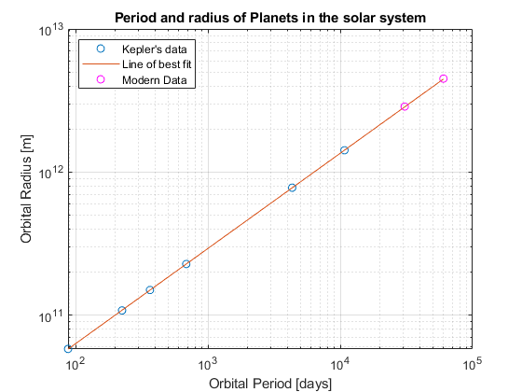
Plotting modern data for Uranus and Neptune
See live script

Slide 10




Thanks!
#UofGWorldChangers
@UofGlasgow

